Slide 1
INTRODUCTION TO ENTREPRENEURSHIP
Prof. Mamoni Banerjee
Rejendra Mishra School of Engineering Entrepreneurship
IIT Kharagpur

Slide 2

WHO IS ENTREPRENEUR ?
An Entrepreneur is an individual who identifies a need in the marketplace and works to fulfil it.
one who organizes, manages, and assumes the risks of a business

Slide 3

WHAT IS ENTREPRENEURSHIP ?
The process of designing, launching and running a new business.
The capacity and willingness to develop, organize and manage a business venture along with any of its risks in order to make profit.

Slide 4

WHAT IS ENTERPRISE ?
Organisation or Enterprise means to plan a business, to start it and run it.
actions of someone who shows some initiative by taking a risk by setting up, investing in and running a business.

Slide 5

WHY ENTREPRENEURSHIP ?
Admire other entrepreneurs
Unemployment
Need to learn more
Profit making
Don’t want to have a boss
Can’t handle a 9-to-5 job
Like risks

Slide 6
Entrepreneur
Entrepreneurship
Enterprise
Person
Process or Philosophy
Object

Slide 7
CONCEPT OF ENTREPRENEURSHIP
Entrepreneurship is an innovative function.
It is a leadership rather than a ownership.
The process of innovation may be in the form of:
Introduction of a New Product
Use of a New Method of production
Opening of a New Market
The conquest of New Source of supplying raw material.

Slide 8
CHARACTERISTICS OF ENTREPRENEURSHIP
Commitment
Self belief
Disciplined dedication
Resourcefulness
Innovative
Adaptable & flexible
Knowledge of the product/market
Dependability
Productivity
Money management skills
Risk Taker
Effective planning skills
Excellent Communication skills
Technical knowledge & skills

Slide 9

ROLE OF ENTREPRENEURS WITHIN THE ECONOMY
Capital formulations: entrepreneurs mobilize the idle saving of the public through the issue of industrial securities.
Improvement in per capita income
Generation of employment
Improvement of the living standard
Economic independence
Balances regional development
Innovation: the commercial application of invention
Imitating role

Slide 10
How Idea Pops-up in Mind
Gut Feeling
Market Research & Survey
Work Experience in the Business Segment
Diversification of Family Business
Expansion of Family Business – inn allied business segment
“If your mind can conceive it, your heart can believe it, then you can achieve it.”
“No idea is a small idea” - Dhirubhai Ambani

Slide 11
Self-Assessment
“The pursuit of opportunity without regard to resources currently controlled.”
- Howard Stevenson (Harvard)

Slide 12
Ask Questions To Yourself Before Starting Business
Am I a visionary?
Am I focused enough?
Am I determined enough?
Am I energetic enough?
Am I a risk-taker?
Am I self-confident?
Am I creative? Do I have tolerance for failure?
Do I have tolerance for ambiguity?
Do I have experience in the field?
Do I have resources – finance, collateral?

Slide 13
Market Assessment
“The founding of new businesses is the essence of entrepreneurial activity.”
- W. Gibb Dyer, Jr. (BYU)

Slide 14
Ask Questions About Market Before Starting Business
Is there a demand-supply gap?
Can I trap the gap?
Can I bump-out a competitor?
Can I develop a unique business model?
Can I make my share in the niche-market by proposing Unique Sale Proposition (USP)?
Can I innovate a product that is readily accepted in market?

Slide 15
Why The Present Time is So Great
India now has the consumption power
If we do not create capability, our dependence on foreign goods will only increase making them richer.
We have demographic advantage.
We are rich in natural resources.
No dearth of knowledge workers.
Government policies are very favorable.
Matured ecosystem in place.

Slide 16

Domestic or Global?
Drawbacks to Global
More research and less accessible connections in startup phase, more travel time required, more considerations.
Advantages to Global
More human resources, more demand, more financing, easier to start global than go from domestic to global.

Slide 17
Pros And Cons Of Entrepreneurship
Pros | Cons
The freedom to pursue your own vision | Work schedule
Potential earnings of an entrepreneur exceed A salaried employee | No regular salary
The control and flexibility of your own time. | Administrative tasks
The opportunity to learn and gain knowledge | Competition
The sense of pride and fulfilment in accomplishing things | Disruption of ones personal life
The chance to share your learning

Slide 18
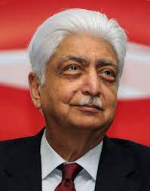
Some of the Real Entrepreneurs
Azim Premji
Chairman of Wipro Limited (one of the largest software company in India)
Honoured with Padma Bhushan in 2005.

Slide 19
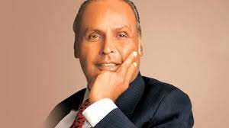
Some of the Real Entrepreneurs
Dhirubhai Ambani
Founder of Reliance Industries
Built India’s largest Private sector

Slide 20
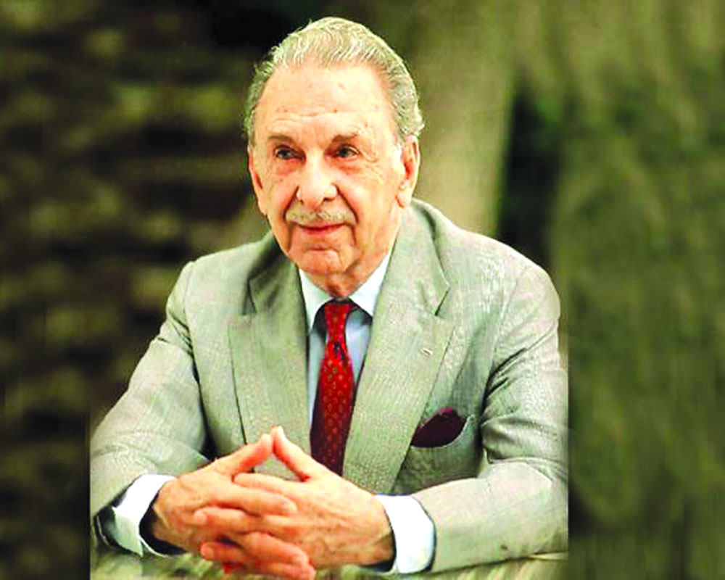
Some of the Real Entrepreneurs
J. R. D. Tata
Chairman of Tata & Sons
Launched Air India International
Received Bharat Ratan in 1992

Slide 21
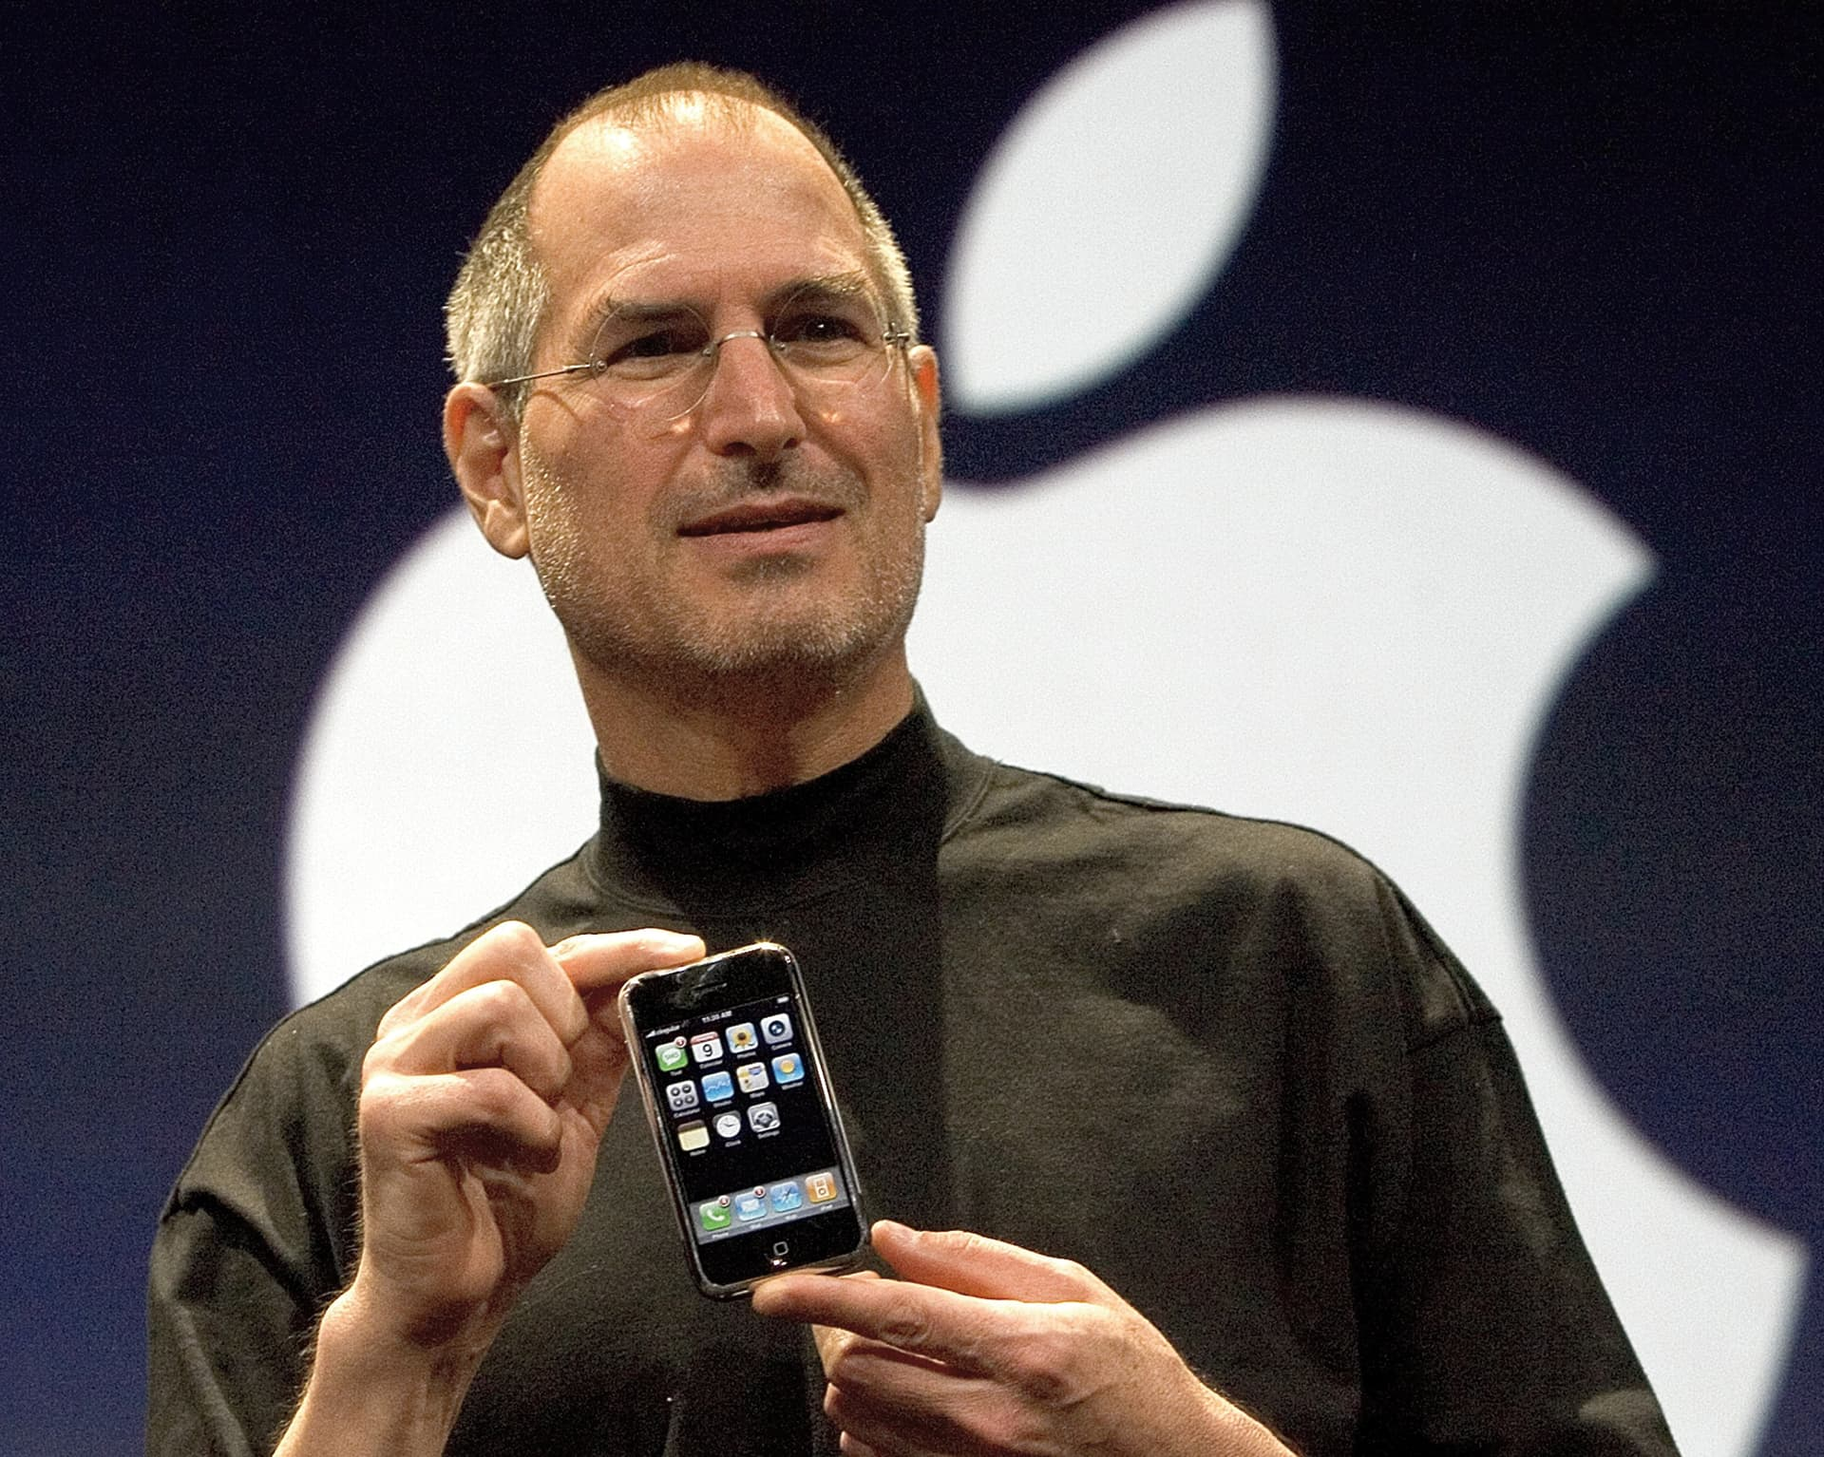
Some of the Real Entrepreneurs
Steve Jobs
Chairman, chief executive officer (CEO), and co-founder of apple inc.
The chairman and majority shareholder of pixar.

Slide 22
Thank You

